Slide 1
Cars Sold Vs Accidents

Slide 2
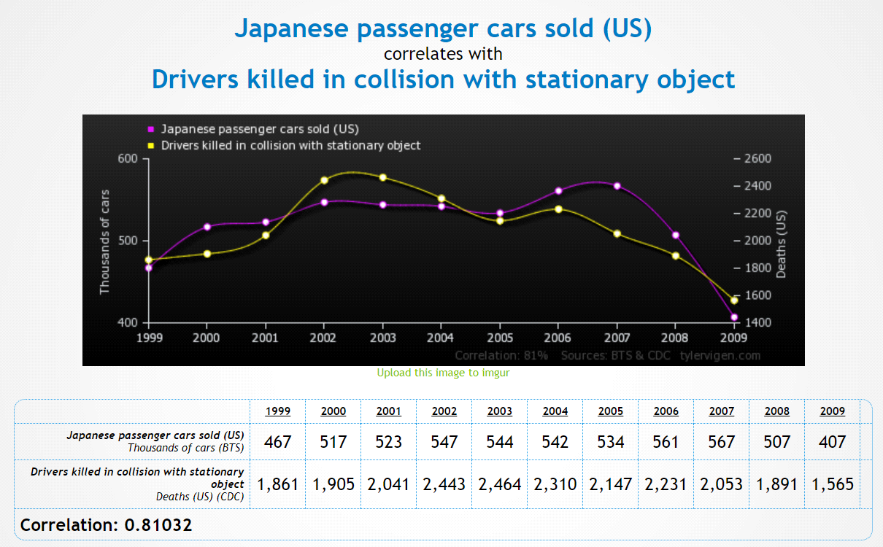

Slide 3
Correlation Analysis on the Conclusion
Conclusion : Japanese car company intentionally adjust the car, which leads to people’s death
As we have about 80% correlation, we can conclude that there is a linear relationship between the number of cars sold and number of accidents.
We can also perform a statistical test to reconfirm the same.

Slide 4
Statistical Analysis on the Conclusion using ANOVA
Conclusion : Japanese car company intentionally adjust the car, which leads to people’s death
Null Hypothesis (H0): The mean number of accidents is the same across different numbers of cars sold.
Alternative Hypothesis (H1): The mean number of accidents varies across different numbers of cars sold.

Slide 5
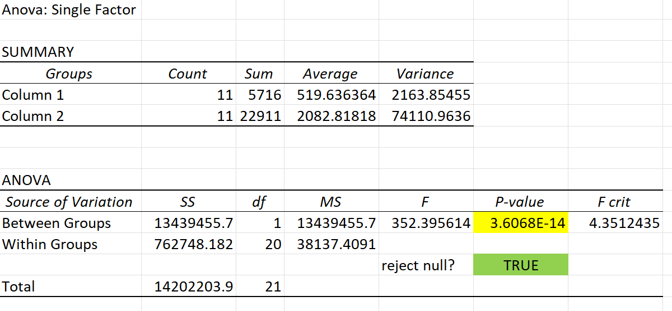
One-way ANOVA Summary

Slide 6
One-way ANOVA Results
At 95% confidence, we could see that p-value is < 0.05 and hence we have to reject the Null Hypothesis
Final Conclusion:
Number of cars sold has a significant effect on the number of accidents

